Slide 1


Create a Visual Dashboard for Churn Modeling

Slide 2
Approach
Our approach was about identifying prominent trends by segregating the data of customers into different buckets
We analyzed the customer data based on
The gender of the customers
The kind of internet services they use
Whether they have multiple lines or not and
The monthly charges paid by them
Further we plotted the churn rate of these categories of customers to find out trends which can be leveraged to target that category which is most likely to churn

Slide 3
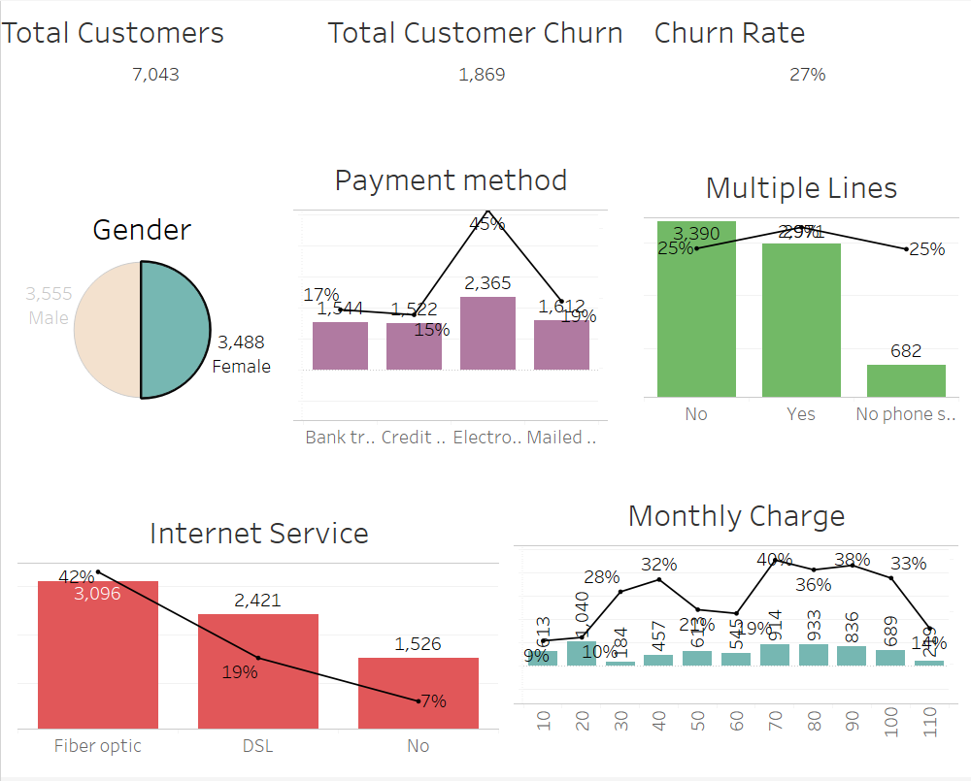
Full Dashboard

Slide 4
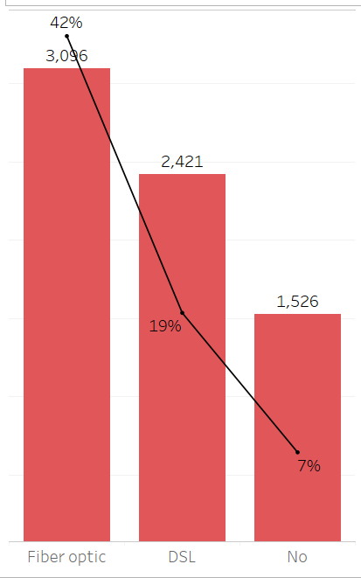

Analysis based on the kind of internet services opted for by the existing users:
Per analysis, we found:
3096 customers opted for fiber optics
These customers have a churn rate of 42%
2421 customers opted for DSL
These customers have a churn rate of 19%
1526 customers did not opt for any internet service
These customers have a churn rate of 7%
Insight : Customers who opt for fiber optics have higher tendency to leave the network

Slide 5
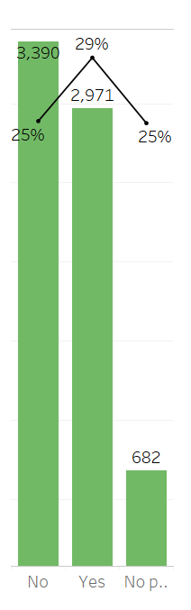
Analysis based on whether the customer opted for multiple lines or not
3390 customers had a phone service but were not using multiple lines
These customers had a churn rate of 25%
2971 customers had a phone service and were using multiple lines
These customers had a churn rate of 29%
682 customers did not have a phone service
These customers had a churn rate of 25%
Insight : Customers that use the phone service and have multiple lines have the highest churn rate of 29%

Slide 6
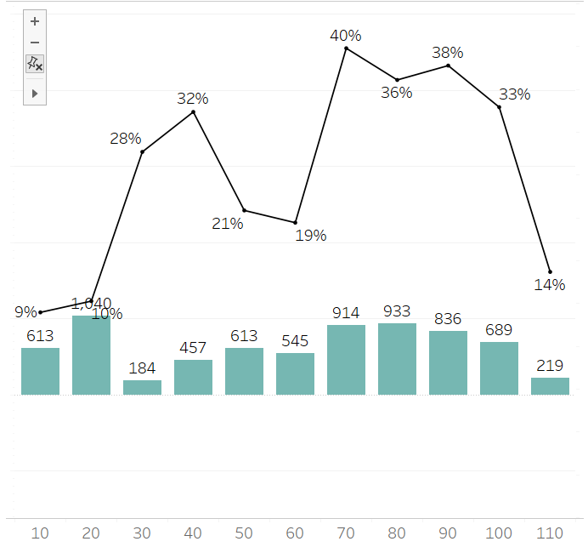
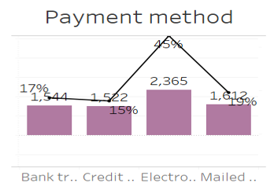
Analysis based on monthly charges paid and payment method by the existing users:
Per analysis, we found:
Insight :
Customers who pay in the range of the 70 bin have highest churn rate of 40% followed by the bin of 90 and 80
Lowest churn rate is that of the monthly charge bin 10
Customer who pay through Electronic Check have highest churn rate of 45%

Slide 7
THANK YOU

